Slide 1
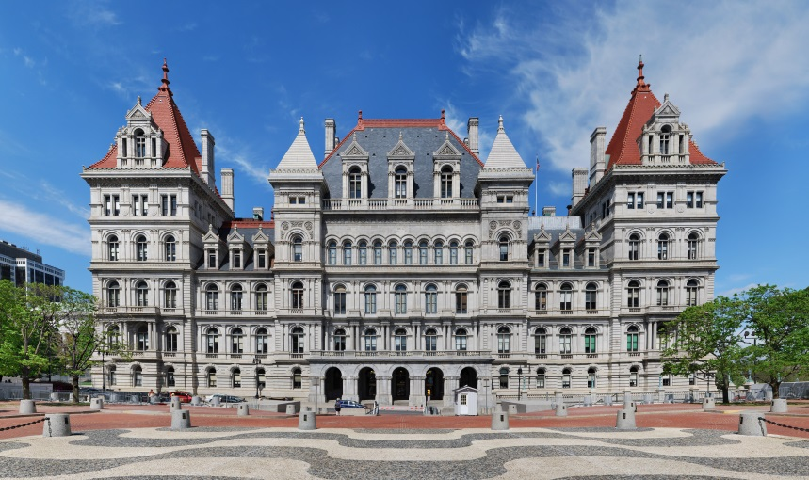
Constitutional Convention
Assemblymember Harry B. Bronson
Assembly District 138
840 University Ave.
Rochester, NY 14607
(585)244-5255
bronsonh@nyassembly.gov
@HarryBBronson
@AssemblymemberBronson
@Harry.Bronson

Slide 2
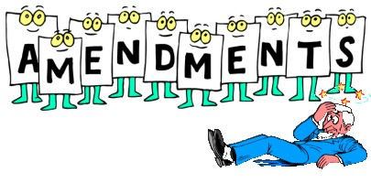
Article XIX of Constitution provides 2 methods of amending the constitution
Proposed by the Senate or Assembly
1. Passed by two successive separately elected Legislatures (Assembly & Senate)
2. Ratified by the Electorate (voters)
Constitutional Convention
1. Automatic ballot question every 20 years
2. Ballot question proscribed by the Legislature
Over two hundred amendments have been added to the constitution in the past century
The statewide referendum process has by far been the predominant method

Slide 3
What is the Constitutional Convention?
Every 20 years New Yorkers have the chance to vote on whether to hold a constitutional convention
The last convention was held in 1967; it was rejected in both 1977 and 1997
This November voters will decide whether or not to have a constitutional convention
This convention would be held in 2019

Slide 4
Past Convention Votes
1914: Vote to hold Convention passes 50.2% to 49.7%
1915 Convention: Voters reject 33 constitutional language changes and 5 amendments
1936: Vote to hold Convention passes 54.2% to 45.7%
1938 Convention: Voters accept 6 and reject 3 amendments
1957: Vote to hold a Convention fails 47.5% to 52.4%
1967: Vote to hold Convention passes 53.3% to 46.6%
1967 Convention: Voters reject major rewrite of Constitution
1977: Vote to hold a Convention fails 40.3% to 59.6%
1997: Vote to hold a Convention fails 37.1% to 62.9%

Slide 5
How would it work?
2017: The question is submitted to the voters
2018: Delegates Elected to the Convention at the General Election
2019: Delegates Convene on the First Tuesday of April
204 delegates would be sent to the convention
3 elected from each of the state’s 63 Senate districts (189)
Plus 15 at-large delegates elected by voters statewide
204 Total Delegates
2019 or later: Proposed amendments would be Amendments submitted to the voters (in 2019 or later)
2020 or later: Any approved amendments take effect in January of the following year

Slide 6
New York Article XIX Constitutional Convention Process, 2017 - 2020
Source: BallotPedia
Notes:
https://ballotpedia.org/New_York_Proposal_1,_Constitutional_Convention_Question_%282017%29

Slide 7
Pro - Convention
Many advocacy groups see this as a faster way to enact changes they wish to see in NYS
Examples include: voting reform, legalization of marijuana, codifying abortion rights, gun rights, budget and pension reform, campaign finance rules, judicial reorganization, and ethics reform
Voters decide:
Whether convention will be held
Delegates to send to convention
Which proposed measures become law

Slide 8
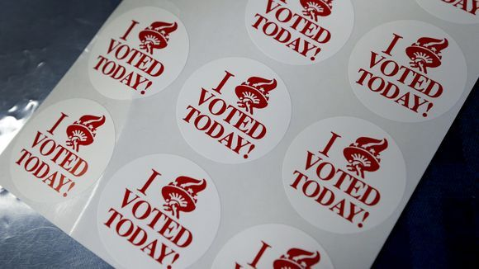
Push for voting & ethics reform
Make it easier for New Yorkers to vote:
Early voting
Same day registration
Automatic voter registration
No excuse absentee balloting
Parolee voting
Student preregistration
Create term limits on the governor, the attorney general, the state comptroller, state senators or assemblypersons
Limit outside income for legislators
Public financing system for campaigns

Slide 9
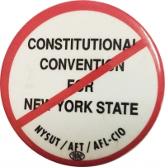
Anti - Convention
Lack of limitations or oversight
Funded at tax-payer expense
Controlled by special-interest groups and lobbyists
Could allow devastating changes to our state’s constitution that would impact all people

Slide 10
No Limits
A convention sets its own rules, hires its own staff, and determines the length of the convention
No timeline for the convention
No oversight on staff hires
Electing officers and organizational decisions are left to those elected to serve as delegates
Can address any issue or area they see fit
Could remove protections on many groups of people
Decide whether voters will ratify each amendment individually or vote on the package as a whole
Determines when to adjourn but submissions cannot occur sooner than six weeks

Slide 11
Financial cost
A constitutional convention is estimated to cost in the tens or hundreds of millions
Each of the 204 delegates would:
Receive a salary of at least $79,500
That is a $16,218,000 cost for the delegates
Get to hire their own staff
Receive pension credits
Since the delegates decide the length of the convention this could be a significant expense
Those likely to be elected will be legislators, judges
As a convention delegate they would receive pay and pension credits on top of their current salary and benefits

Slide 12
1967 Convention Delegate Breakdown
67% of the delegates were lawyers
25% were a legislator at one time
15% served in the judicial system at one time
50% served in a political party office at one time during their career
Speaker of the Assembly served as President of the Convention

Slide 13
Role of special-interests
Well-funded special-interests will dominate the convention to rewrite constitution for their own benefit
Big corporations and lobbyists will see this as a way to enact their agenda → which is why they are openly pushing for a convention
Major political parties and other groups will try to control the convention process

Slide 14
What is at risk?
Public Employees
Diminishment of pensions prohibited – Article 5, Sec. 7
Local Governments authorized to increase pension for police and fire – Article 8, Sec. 1
Civil Service Protections – Article 5, Sec. 6
All Workers, Private Sector
Workers’ Compensation & Worksite Safety - Very strongly worded – Article 1, Sec. 18
Includes Unemployment
Labor not a commodity:
Right on public works to 8/40 hours day/week, Right to collective bargaining – Article 1, Sec. 17
Authorization of Gambling (casinos, lottery, racing) – Article 10, Sec. 1
Building Trades
Public Works & Prevailing rate – Article 1, Sec. 17

Slide 15
Counter-argument
Pro-convention groups argue that a convention would not reduce or eliminate the pensions of current public employees and retirees
Any proposed changes would only impact future employees
Some believe convention could actually be an opportunity to strengthen rights for public employees
Argue that NYS has a high public employee population
New Yorkers would support public unions→ would not elect delegates or approve changes that would harm public employees

Slide 16
Other Risks
Anti-discrimination efforts
Push for religious freedom against same-sex marriage and reproductive rights
Public education
Social welfare needs
Rollback of conservation efforts
→Far more could be lost than gained

Slide 17
Free Public Education
Right to a free public education is guaranteed in our state constitution (Article 11, Sec 1)
Eliminating our constitutional guarantee to a free public education would seriously endanger the quality of our public schools
Public education is already under threat on the federal level under the current administration
Any deterioration of our public schools would negatively affect the lives of all people and the strength of our communities

Slide 18
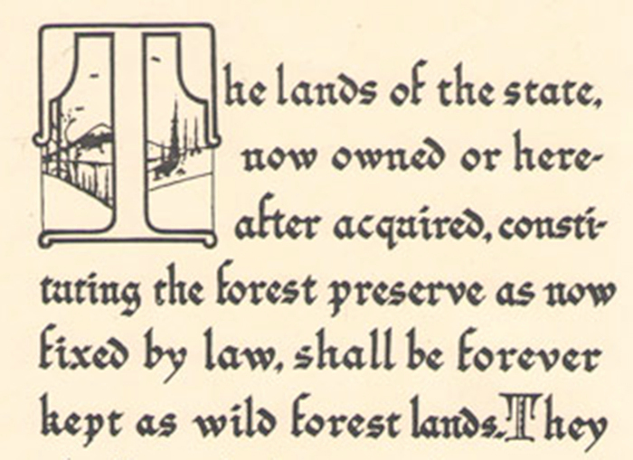
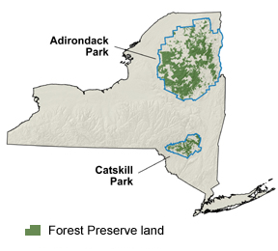
“Forever Wild”
Concerns that the 125-year-old "forever wild" clause of the state constitution (Article XIV) could be amended without proper deliberation or scientific study
Protects approximately three million acres of Forest Preserve inside the Adirondack and Catskill Parks
And a much smaller amount outside the Parks but within defined Forest Preserve counties

Slide 19
New Yorkers Against Corruption
Over 100 organizations have formed a coalition against the constitutional convention titled New Yorkers Against Corruption
From a broad and diverse ideological spectrum
Groups such as: Adirondack Council, NYS Conservative Party, Council of Churches, CSEA, Environmental Advocates of New York, Equality New York, New York State AFL-CIO, NYS Public Employees Federation (PEF), NYSUT, Planned Parenthood Empire State Acts, Pride at Work - Rochester/Finger Lakes, Rochester Metro Justice, Rochester Next Up, Teamsters Local 814, & Many Others
These groups are united by the belief that a constitutional convention could have potentially destructive consequences, for a high financial cost, with little to show at the end

Slide 20
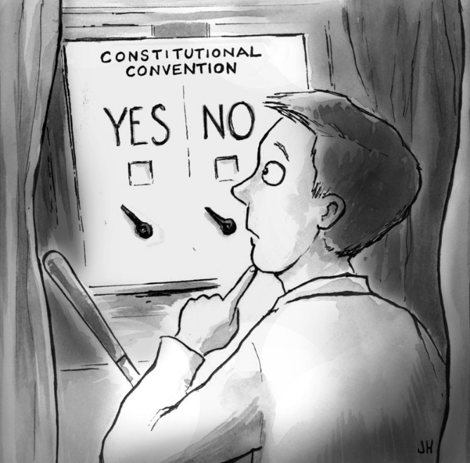
Conclusion
Overall a constitutional convention would be:
Expensive
Time-consuming
High-risk for many groups and vital protections
With no guaranteed end result!

Slide 21
Thank You!
Assemblymember Harry B. Bronson
Assembly District 138
840 University Ave.
Rochester, NY 14607
(585)244-5255
bronsonh@nyassembly.gov
@HarryBBronson
@AssemblymemberBronson
@Harry.Bronson

